Slide 1
UN-GGIM Americas
Access and Use of Geospatial Information for Disasters and Climate Change
Gap Analysis and Future Work
UN-GGIM Americas report
Mexico City
11 September 2019
Nouri Sabo
Louis Brown

Slide 2
Presentation contents
The Americas Region
Priorities of the Global Strategic Framework
UN-GGIM Americas Working Groups
Survey Results and Gap Analysis
Future Work

Slide 3
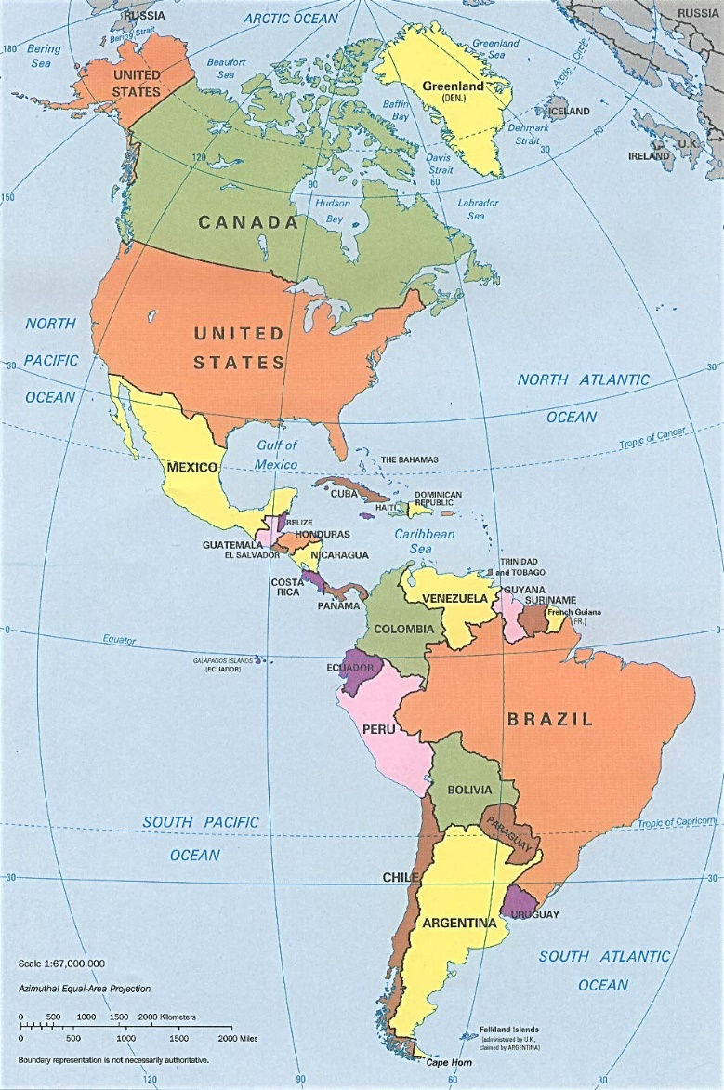
The Americas Region
Spans both hemispheres, north and south
40 independent countries plus several Caribbean Overseas Countries and Territorries (OCT’s)
16 million square miles
Population 1 billion plus
Main languages: English, Spanish, Portuguese, French
Disasters : flooding, hurricanes, landslides, wildfires, earthquakes, volcanos, tsunamis, droughts, disease outbreaks
By CIA, original political map from Perry-Castañeda Library Map Collection University of Texas Library Online, Public Domain, https://commons.wikimedia.org/w/index.php?curid=1839902

Slide 4
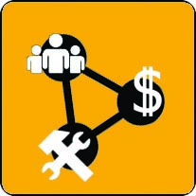
GSF : Five Priorities for Action
Governance and Policies
Awareness Raising and Capacity Building
Data Management
Common Infrastructure and Services
Resource Mobilization

Slide 5
Gap Analysis - Summary
Low (small gap) to High (large gap)
GSF priority areas for action | North America | Caribbean | Central America | South America
Governance and Policies | Low | High | High | Average
Awareness Raising and Capacity Building | Average | High | High | High
Data Management | Low | Average | Average | Average
Common Infrastructure and Services | Average | High | Average | Average
Resource Mobilization | Average | High | High | High
Interpretation hints
Governance and Policies: collaboration, information sharing, roles and responsibilities, geospatial information standards
Awareness Raising and Capacity Building: training and education, VGI, etc.
Data Management: continued management of geospatial datastores
Common Infrastructure and Services: interoperability and collaboration
Resource Mobilization: fast deployment of trained human resources and general resources

Slide 6
Future Work
Finalize survey and gap analysis report after final comments received from member states, as the basis for the capacity building initiatives.
Organize task forces around selected GSF action items for articulation of capacity building implementation plans.
1. Governance and Policies (Mexico)
2. Awareness Raising and Capacity Building (Canada)
3. Data Management (Argentina)
4. Common Infrastructure and Services (Nicaragua)
5. Resource Mobilization (Guyana)
Terms of reference for task forces completed in December 2019
Collaborate with UNGGIM working group on disasters and regional organizations (AmeriGEO, NASA) to identify and articulate project initiatives and support for capacity building (leave no one behind).
Organize capacity building workshops starting in August 2020.

