Slide 1
Integration of Statistical and Geospatial Information in Central America
Pan American Institute of Geography and History
2019 Technical Assistance Project
Led by the United States National Section of PAIGH and UNGGIM: Americas
Notes:
Thank you all for attending this meeting to discuss the 2019 PAIGH Technical Assistance Project for the Integration of Statistical and Geospatial Information in Central America.

Slide 2
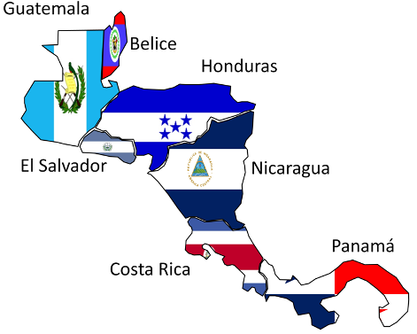
Project Purpose
To integrate statistical and geospatial information in Central America, building upon the efforts of the:
Pan American Institute of Geography and History (PAIGH)
United Nations Statistics Division (UNSD)
United Nations Committee of Experts on Global Geospatial Information Management (UN-GGIM)
UN-GGIM: Americas
Economic Commission for Latin America and the Caribbean (ECLAC)
Notes:
Many organizations are striving to integrate statistical and geospatial with the goal of informing and improving decision making.
This project builds on the work and efforts underway by:
PAIGH, including the finalization of the Integrated Maps of Central America (MIAC) and South America (MIAN, MIAS)
The UN Statistics Division
The United Nations Committee of Experts on Global Geospatial Information Management (UN-GGIM)
UN-GGIM: Americas
The Economic Commission for Latin America and the Caribbean (ECLAC)
Back pocket - additional work being done by:
Columbia’s National Administrative Department of Statistics (DANE)
The Geospatial Network of Latin America and the Caribbean (GeoSUR)

Slide 3
Why is data integration important?
Increasing knowledge sharing nationally and regionally
Building relationships that continue collaboration beyond the project timeline
Encouraging innovation for data analyses and visualization
Informing decision makers
Notes:
Why is data integration important?
Data integration projects such as this will increase knowledge sharing and build relationships between agencies and countries that will hopefully continue collaborating beyond the project’s scope.
Integrating data allows for new forms of analysis and visualization creating informed decision makers.

Slide 4
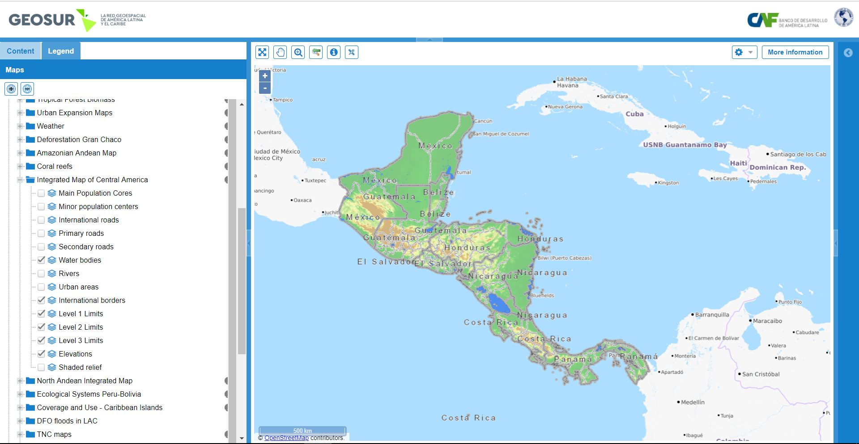
Notes:
As we look to create a model for data integration in Central America, the MIAC is an excellent foundation to build upon.
Background:
During the 48th Directing Council Meeting of the PAIGH it was resolved that the Integrated Map of the Americas should be the basis for the development of projects involving statistics, climate change, and natural risk reduction, among others. The Integrated Map of Central America (MIAC) will be the framework on which this and future data integration projects will be built while ensuring that there will not be a duplication of efforts with various projects.
This map, which is hosted on GEOSUR, represents a successful collaboration resulting in invaluable data being disseminated publicly. The goal of our technical project is to expand on this collaboration and to enhance it through the integration of statistical data.

Slide 5
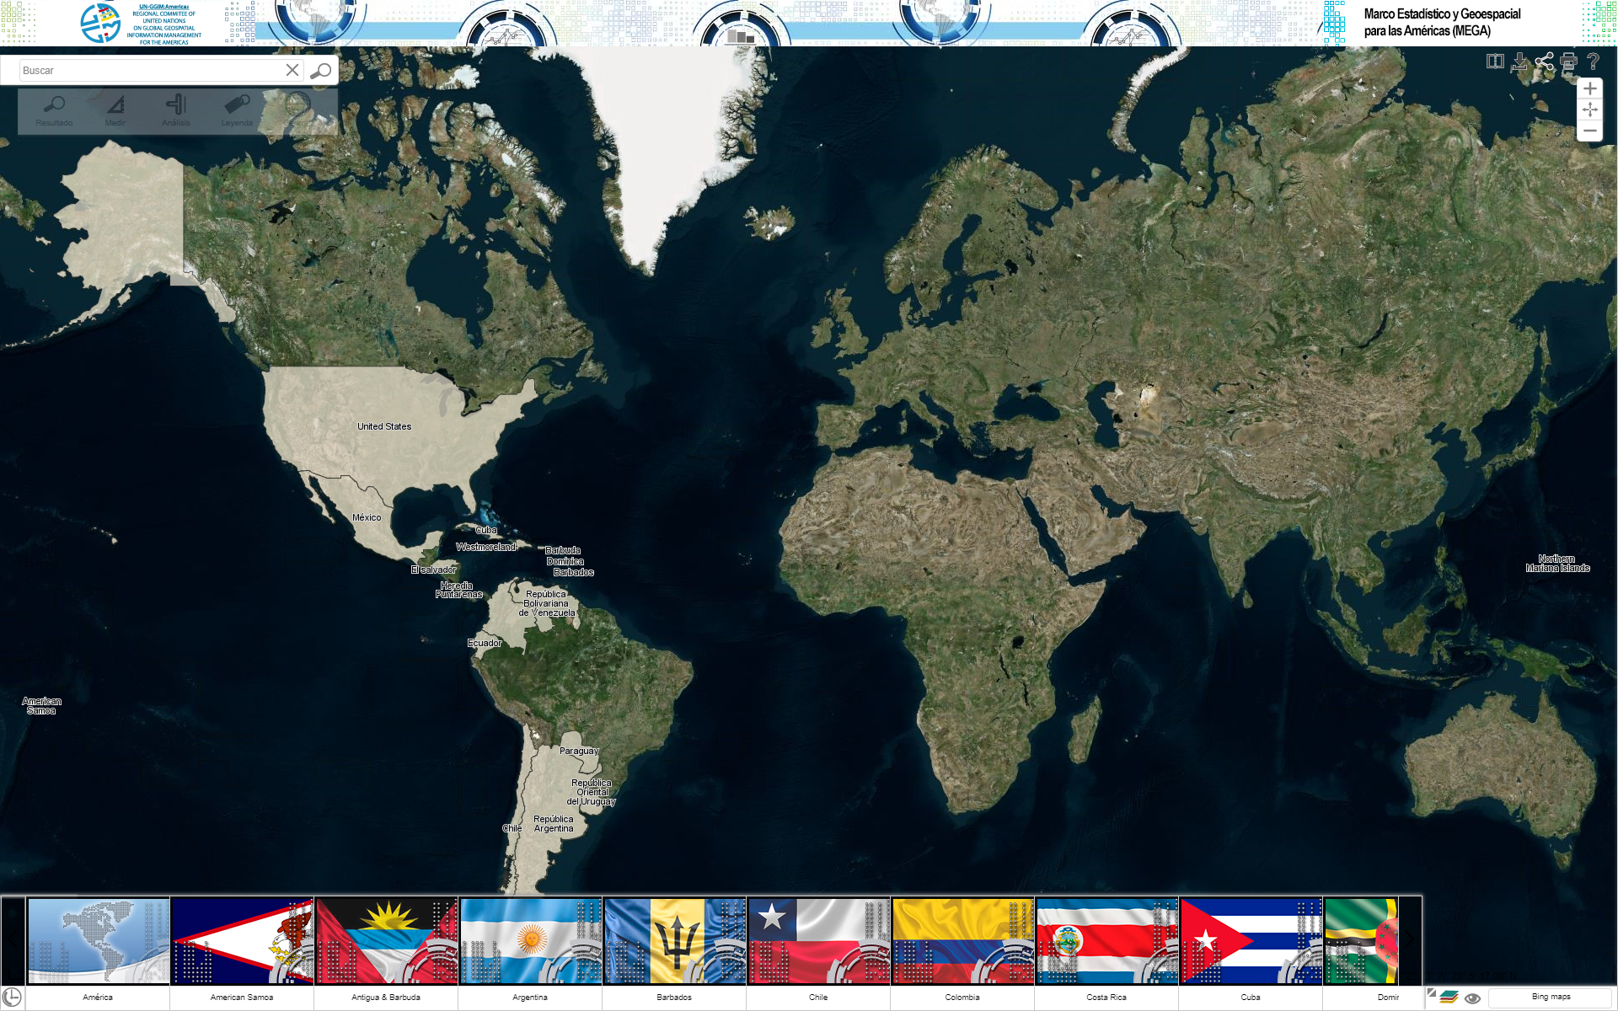
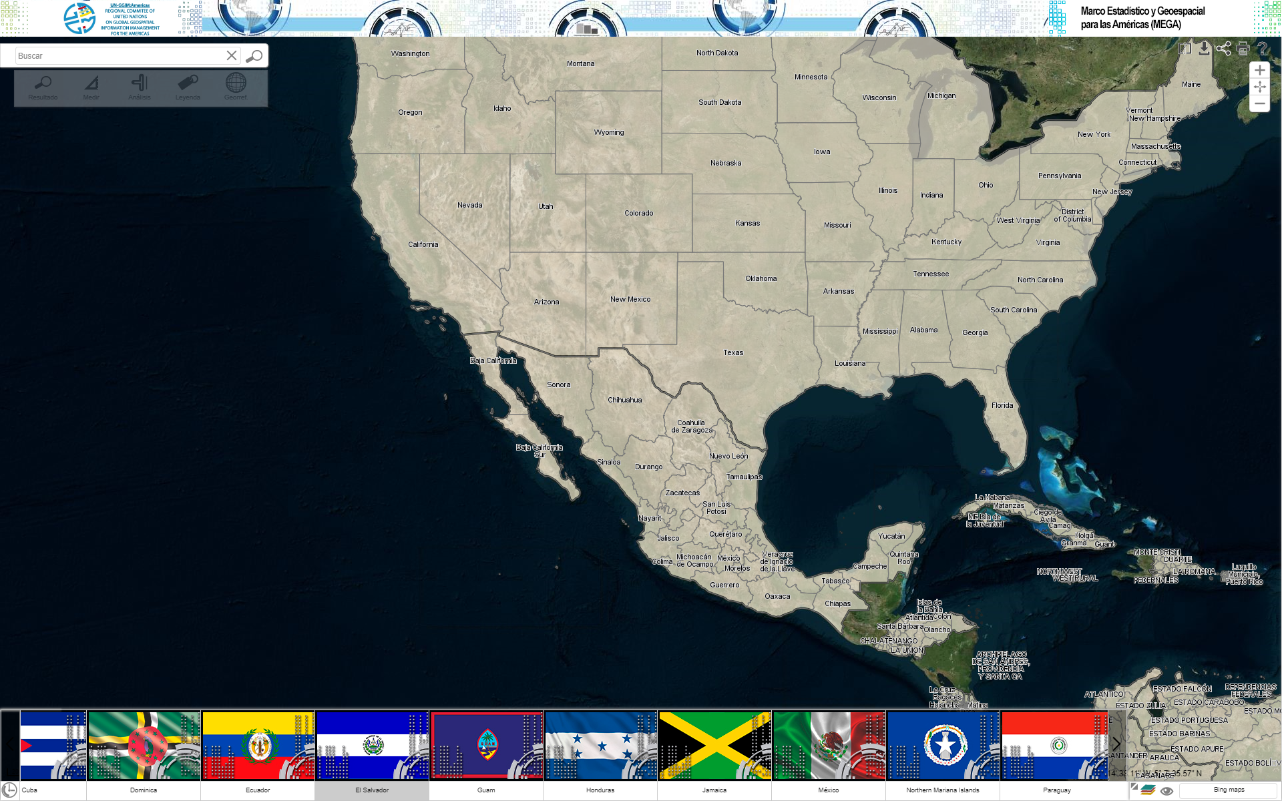
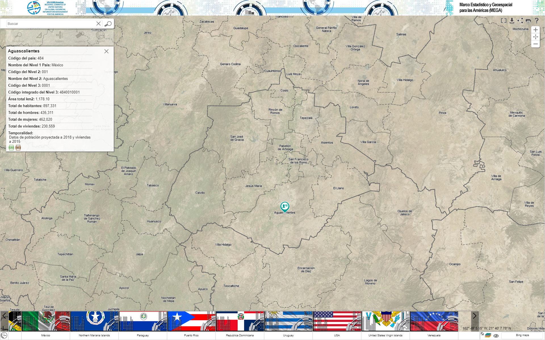
Notes:
The Statistical and Geospatial Framework for the Americas (MEGA) is an example of a successful data integration project currently underway. Statistical data are gathered at the highest levels ….. But it has not received full participation to date. The United States has participated by submitting 3 levels of geography with statistical data related to population and housing.
Background:
US
Nivel_1_UnitedStates (US boundaries (tl_2017_us_state dissolved/2017 Population Estimates for POP/HU))
Nivel_2_UnitedStates (State boundaries (tl_2017_us_state/2017 Population Estimates for Pop/HU))
Nivel_3_UnitedStates (County boundaries (tl_2017_us_county/2017 Population Estimates for Pop/HU))
PR:
Nivel_1_PuertoRico (PR boundary (tl_2017_us_state/ACS16 5-yr for Pop/HU))
Nivel_2_PuertoRico (PR municipios (tl_2017_us_county/ACS16 5-yr for Pop/HU))
Nivel_3_PuertoRico (PR barrios (tl_2017_72_cousub/ACS16 5-yr for Pop/HU))
Island Areas:
Nivel_1_AmericanSamoa (AS boundary (tl_2017_us_state/Census 2010 for Pop/HU))
Nivel_1_Guam (Guam boundary (tl_2017_us_state/Census 2010 for Pop/HU))
Nivel_1_NorthernMarianaIslands (CNMI boundary (tl_2017_us_state/Census 2010 for Pop/HU))
Nivel_1_VirginIslandsUS (USVI boundary (tl_2017_us_state/Census 2010 for Pop/HU))

Slide 6
Project Objectives
GATHER PARTICIPANTS AND KNOWLEDGE
IDENTIFY PROBLEMS, PRIORITIES, & INNOVATIVE INTEGRATION METHODS
COALITION AND AWARENESS BUILDING
DEVELOP PLANS AND REPORTS
Notes:
There are four key objectives to this project.
To gather information - to assess and understand the statistical and geospatial capacity of each country in Central America and to increase knowledge of the national and regional efforts of the organizations I just mentioned on the last slide.
To identify problems, priorities, and innovative integration methods to be utilized for this project. We want to better understand the work currently underway to integrate geospatial and statistical information in Central America and how it is being used in decision making within each country and the region. To do this, we want to identify the problems participants feel can be solved by data integration and develop methods to effectively display and analyze the statistical and geospatial data once integrated.
Arguably, the most important aspect of this project - we want to build a coalition and relationships that raise awareness of the importance of data integration and how we can best work together to achieve this successfully in Central America. This will contribute significantly to the success of this and future integrative and cooperative projects. Many of the participants and agencies of this project may be working together for the first time on such a collaborative effort and we hope that this will enable knowledge sharing between agencies and countries even beyond the scope of this project.
Develop plans and reports on the status and progress of the project and develop future plans for integration. This will be done by sharing these reports on the PAIGH website. Each quarter, we are creating summary reports on the progress we have made, results of work accomplished, and action items for the next quarter. An additional deliverable of this project will be a detailed plan for the integration of statistical and geospatial data in 2020. We will discuss the quarterly reports and a 2020 integration plan in more detail in a few slides.

Slide 7
Executive Partners and Collaborators
PAIGH
UN-GGIM: Americas
ECLAC
The Center for Geographic Information (CNIG) of the National Geographic Institute (NGI) of Spain
$13,205
10/23/2018
Notes:
This project is funded by PAIGH. The Initial funding amount was $13,205, approved on October 23, 2018.
Representatives from the US National Section of PAIGH and UN-GGIM: Americas (INEGI) are leading the project.
We are receiving in-kind support from all supporting partners – INEGI, Census, SIRGAS, GeoSUR, ECLAC and CNIG

Slide 8
Identified Agencies
Belize | Costa Rica | El Salvador | Guatemala | Honduras | Nicaragua | Panama
Statistical Institute of Belize | National Geographic Institute | National Records Center | National Geographic Institute | National System of Property Management Republic of Honduras | Nicaraguan Institute of Territorial Studies | National Geographic Institute Tommy Guardia
Ministry of Natural Resources | National Institute of Statistics and Census | General Directorate of Statistics and Census | National Institute of Statistics | National Institute of Statistics | National Institute of Development Information | National Institute of Statistics and Census
Ministry of Foreign Affairs | University of Costa Rica |  |  |  |  | Comptroller General of the Republic
Notes:
The initial phase of this project involved identifying and inviting statistical, geospatial and academic organizations to participate in this project. These are the agencies that were identified from each country.
In addition, we have participants from:
INEGI
U.S. Census Bureau
Economic Commission for Latin America and the Caribbean (ECLAC)
Center for Geographic Information (NNIG) of the National Geographic Institute (NGI) of Spain.
SIRGAS
GeoSUR
An invitation letter was sent to 31 participants representing the 23 organizations in January 2019
We received responses from 25 representatives from 15 organizations.

Slide 9
Project Phases and Schedule
PHASE II
PHASE III
PHASE IV
Proposed
Conduct informational workshop
Conduct technical workshop
Publish the results and products
PHASE I
Gather information
Identify statistical & geospatial capacity
Questionnaire
Set date of informational workshop (phase II or III)
Meet with participants at international conferences/meetings
Create geographic crosswalk between each Central American country, U.S., and Mexico
Create plan for 2020 integration
Publish results and products
Revised
January – March 2019
April – June 2019
July – September 2019
October – December 2019
Notes:
The timeline that was initially proposed for the project has been modified slightly based on our initial information gathering phase to help refine the scope for this project.
The revised timeline, allows us to:
Develop and administer a questionnaire to help with the information gathering phase of the project and identify potential informational workshop dates
Time to meet with project participants at international conferences and meetings, such as this, and relationship building to accomplish this project
To develop a format to help identify levels of geography that we can integrate to. This will be achieved with a geographic crosswalk that will allow each country to identify levels of geography that are meaningful to them and can be integrated; then, map those to each countries geographies including those of the United States and Mexico.
Then in the remaining two phases of this project to develop a plan for actual integration in 2020.

Slide 10
Phases 1 and 2 Status
Questionnaire
Quarterly Report
Notes:
Phases 1 and 2 are complete.
A quarter 1 report is complete, signed and available
An informational questionnaire was developed and sent to participants to assist in planning future meetings as well as to determine resource availability and current levels of integration. We are in the process of completing the quarter 2 report that will contain the results of the survey.
In the following slides we will share some of the high levels results of the survey.

Slide 11
Survey Responses
Total
Responses
Countries
Organizations
24
10
16
Notes:
We were thrilled to have 24 project participants respond to our questionnaire.
These participants represented 16 unique organizations from 10 different countries.

Slide 12
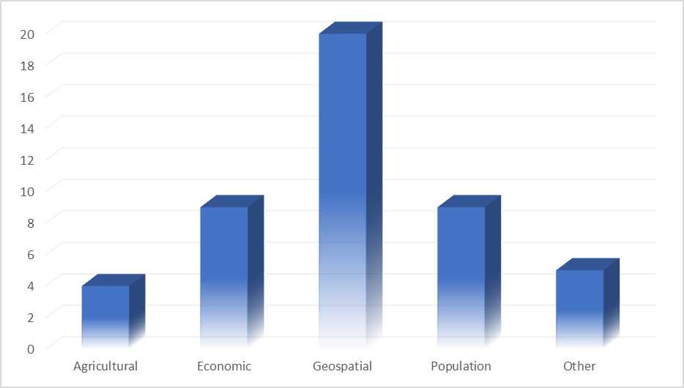
What types of data does your organization currently collect?
Notes:
The overwhelming majority of our respondents represented geospatial organizations, but the questionnaire allowed respondents to select multiple responses to this question to accurately describe and reflect the function of their agency.

Slide 13
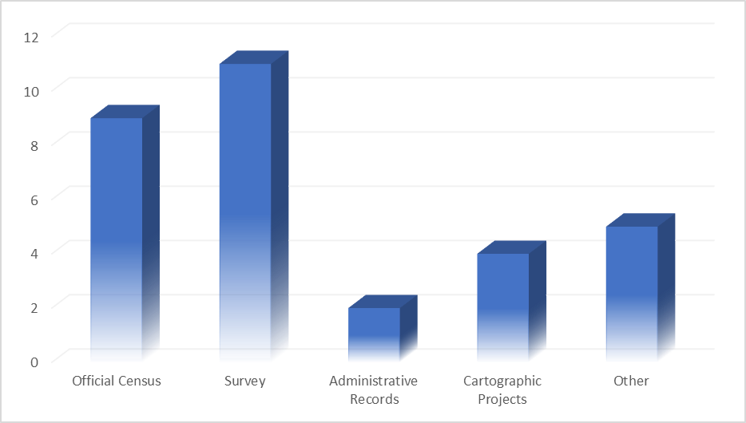
How are the data collected?
Notes:
As you can see, most of the data being collected by these organizations is for official censuses and surveys and cartographic projects.

Slide 14
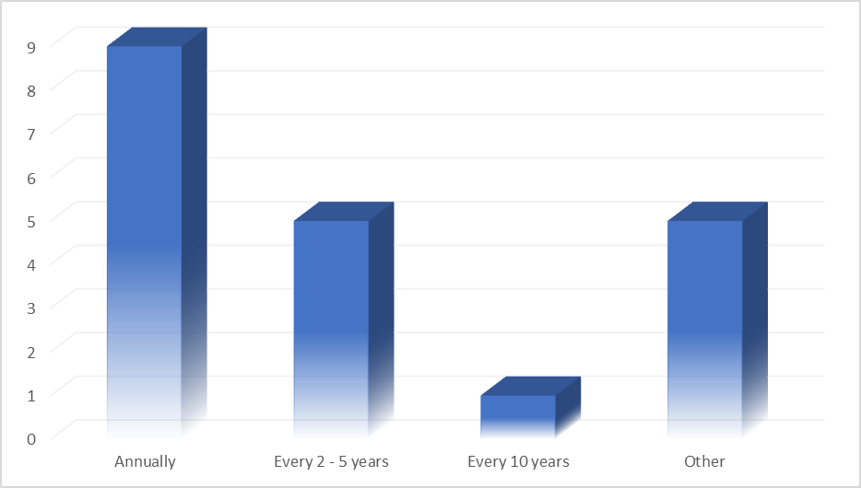
How often are the data collected?
Notes:
It is exciting to see that many of these agencies are collecting data on an annual basis. This will assist this project by providing current data for integration purposes

Slide 15
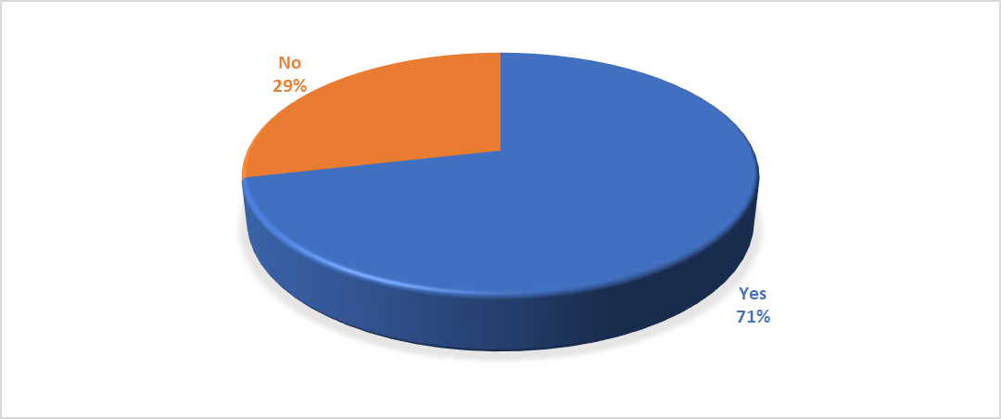
Is your organization currently integrating geospatial and statistical data?
Notes:
71% of respondents indicated that their agencies are already integrating data at some level.

Slide 16
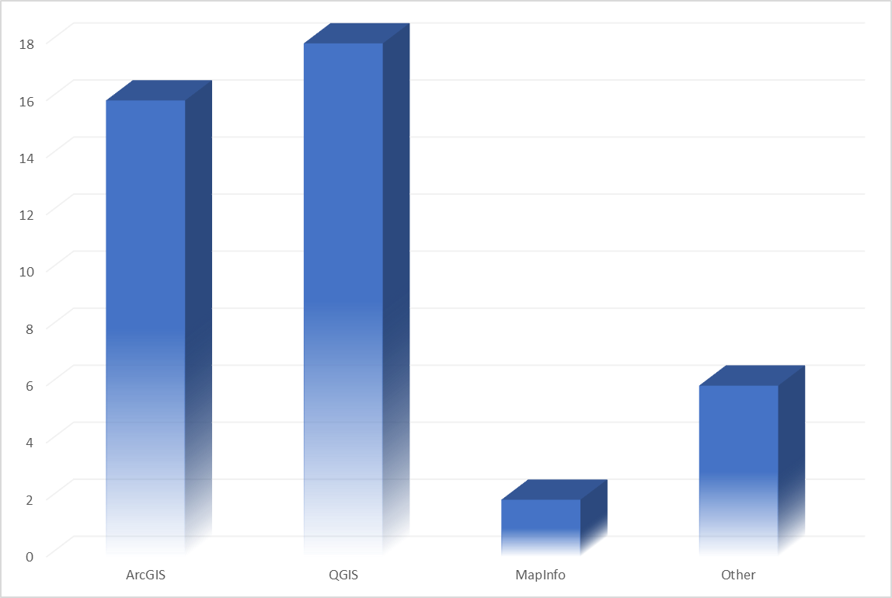
What GIS software is used at your organization?
Notes:
As you can see, most agencies are currently using ArcGIS, QGIS, or both to conduct their geospatial analysis.
I am happy to announce that just a few weeks ago, at the Esri User Conference, PAIGH and Esri entered into a Memorandum of Understanding. With this agreement, PAIGH has successfully secured technical GIS assistance for PAIGH projects and their participants to aid in the integration of statistical and geospatial data.

Slide 17
Future steps
2020 Technical Project proposal
Update geographic crosswalk
Continue coalition building
Determine topics for 2020 integration
Notes:
As we are halfway through our 2019 technical project, we are looking ahead to the remaining phases and to 2020.
We have submitted a PAIGH 2020 technical project proposal for the implementation of our 2020 integration plan that will be developed as a product of this project.
We are actively working to update the geographic crosswalk to include the levels of geography that we wish to integrate. In the next two slides, I will discuss this task further.
We will continue to build relationships by meeting with participants at meetings and conferences.
This week, in conversations with the technical experts, we would like to explore potential topics or themes for 2020 integration that will be the foundation for our 2020 integration plan.

Slide 18
Notes:
A critical element of this project to identify the lowest level of common geography that will allow for meaningful integration in 2020.
As you can see, the Census Bureau’s geographical hierarchy is very complex. Attempting to align these geographies to those of the 7 Central American countries and Mexico will be a difficult undertaking but an important one to build upon the work already underway with the MEGA.

Slide 19
Crosswalk
Notes:
As the MEGA is integrating basic demographic data to the top 3 levels of geography, our integration project will need to expand beyond that with enhanced levels of geography and statistical data. This crosswalk will be updated to reflect the levels of geography that we intend to integrate in 2020.

Slide 20
What is one problem/issue that your organization would like to see addressed as part of this project?
Analysis & Viewer
Other
Standards & Data Sharing
Base Map
Training
Notes:
To help facilitate this discussion, we wanted to share with you a high level summary of responses to the following question in the survey:
We asked questionnaire respondents “What is one problem or issue that your organization would like to see addressed as part of this project?”
The responses of this question fell into 5 basic categories:
Training
Standards and Data Sharing
Having a Base Map of the region
Analysis and Viewer
Other
These are a few of the responses that we received:
Improvement in the processes of data analysis, sharing knowledge, experiences
Develop a dynamic demographic atlas
The integration of maps and statistical data using open OGC standards and publishing open data according to opendefinition.org
The need for these data to be integrated, because at the moment they are separate entities
There are more detailed responses you can reference from this question in the survey.
I would like to take the remaining time to answer any questions you have regarding our project and to open a discussion about which problems or issues that you think would be best addressed by the integration of statistical and geospatial information in the region.

Slide 21
Paloma Merodio Gómez
Presidente
UN-GGIM: Américas
paloma.merodio@inegi.org.mx
(52) 5278.1000 ext. 1557
Deirdre Dalpiaz Bishop
President
United States National Section of PAIGH
deirdre.dalpiaz.bishop@census.gov
(301) 763.1696

