Slide 2
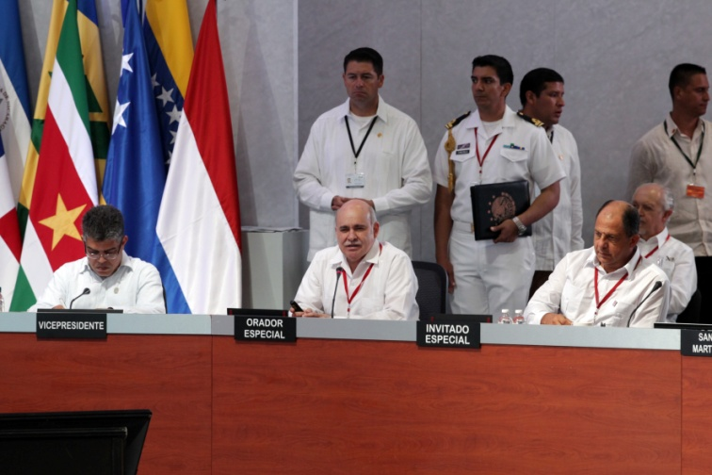
During the Sixth Association of Caribbean States Summit, held in Merida Mexico, on April 30 2014, the Mexican Government proposed new initiatives to promote the development of the Caribbean Region. One of them was the Caribbean Project.
Notes:
In 2014, the mexican government offered the Member countries of the Association of Caribbean States, to carry out a cooperation in the Caribbean region.

Slide 3
Cooperation for the Caribbean Region
A Collaborative agreement between the National Institute of Statistics and Geography (INEGI) and the Mexican Agency for International Development Cooperation (AMEXCID) was signed.
INEGI contributed with the technical support and the Government of Mexico provided the financial support for this project.
The project had the support of the Association of Caribbean States (ACS), who is committed with contributing to the development of the region.
Notes:
In this sense, through a collaboration agreement between the Ministry of Foreign Affairs and the National Institute of Statistics and Geography, the terms of reference were established to carry out the Caribbean Project, in order to reduce the gap in spatial data infrastructure in the región, strengthen the use of geospatial information and support the integration and participation of 17 Caribbean countries in the United Nations Committee of Experts on Global Gesopatial Information Management, through the Regional Committee for the Americas

Slide 4
List of Participants
1
Antigua & Barbuda
10
Haïti
2
Bahamas
11
Jamaica
12
3
Barbados
St Kitts & Nevis
4
Belize
13
St. Lucia
5
Cuba
14
St. Maarten
6
Dominica
15
St. Vincent & the Grenadines
7
Dominican Republic
16
Suriname
8
17
Grenada
Trinidad & Tobago
9
Guyana
Notes:
This is the list of countries that were part of the project

Slide 5
Caribbean Project Components
Diagnosis
Capacity Building
Infrastructure:
Strengthen Geodetic Network
Land Cover Map
Geomatics Solution
Incorporation to UN-GGIM
Notes:
The Project had 4 main components: a diagnosis, a capacity building program, infrastructure acquisition and the incorporation to unggim

Slide 6
Diagnosis of the geospatial information management
Cuestionario de diagnóstico
sobre el estado de la infraestructura de Datos Espaciales(IDE) en los países miembros de la Asociación de Estados del Caribe
Diagnostic Questionnaire
on the state of the Association of Caribbean States member counties´ Spatial Data Infrastructure (SDI)
Questionnaire de diagnostic
sur l´état de l´infrastructure d´information géo-spatiale dans les pays membres de l´Association des États de la Caraïbe
Diagnostic Questionnaire
on the state of the Association of Caribbean States member counties´ Spatial Data Infrastructure (SDI)
Questionnaire de diagnostic
sur l´état de l´infrastructure d´information géo-spatiale dans les pays membres de l´Association des États de la Caraïbe
Notes:
To start the diagnosis, based on previous experience, a questionnaire was designed and translated into English and French; in order to know the status of the Spatial Data Infrastructure in the participating countries.

Slide 7
Elements considered in the diagnosis
Information/
Data availability
Human
resources
Acces Network
Human capital
SDI culture-education
Agreements
Web connectivity
Technology
Geospatial software
availability
Spatial data sets
Spatial data services
Policies
Metadata availability
Notes:
In order to analyze the status of each country, the variables consulted in the questionnaires were grouped into ten major issues related to Spatial Data Infrastructures (SDI).

Slide 8
Courses and Workshops 2014 - 2018
INSTRUCTORS:
Geographic Metadata
Spatial Data Infrastructure
Use of Geodetic Equipment
International Forum on DRR
Geographic Information Systems
Classification with MAD-MEX
Mx-SIG and Geoportals
Geodesy
Tools for SDG’s
LANOT
Geographic Standards
Cartography
Quality of Geospatial Data
QGIS – Free Software Tools
MxSIG Geoportals
Verification with MAD-MEX
Notes:
Based on the diagnosis results, a capacity bulding strategy was designed.
From 2014 to 2018 sixteen workshops were held

Slide 9
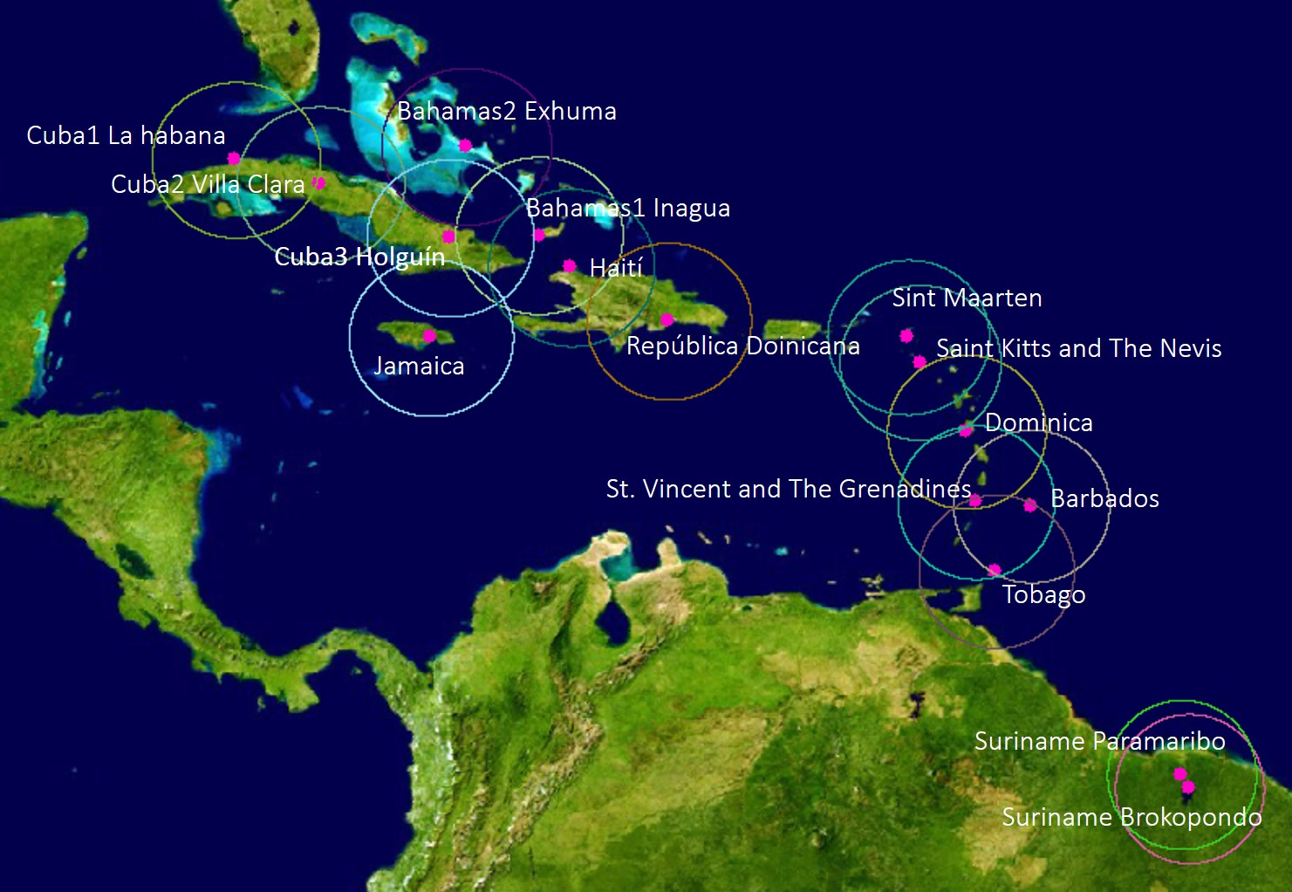
Strengthen the Caribbean Geodetic Network
Notes:
Centre National de I'Information Geó-Spatiale. Impasse Baron #13 bis Turgeau, Port-au Prince – Haiti
Regarding the infrastructure aqcuisition, to strengthen the Caribbean Geodetic Network

Slide 10
Distribution of geodetic equipment
IMAGE
COUNTRY
STATIONS
IMAGE
ROVERS
Antigua & Barbuda
0
2
Bahamas
2
4
Barbados
1
2
Belize
0
2
Cuba
3
4
Dominica
1
2
Grenada
0
2
Guyana
0
4
Haïti
1
4
Jamaica
1
3
Dominican Republic
1
4
St. Kitts and Nevis
1
2
St. Lucia
0
2
St. Marteen
1
2
St. Vincent and the Grenadines
1
2
Suriname
2
0
Trinidad and Tobago
1
2
TOTAL
16
43
Notes:
16 GNSS permanent stations and 43 field equipments were deilvered

Slide 11
Geomatics Solution Digital Map for the Caribbean
Distribution of computer Servers
Country
Quantity
Antigua and Barbuda | 1
Bahamas | 1
Barbados | 1
Dominica | 1
Grenada | 1
Guyana | 1
Haïti | 1
Jamaica | 1
Saint Kitts and Nevis | 1
Saint Lucia | 1
Sint Maarten | 1
Saint Vincent and the Grenadines | 1
Suriname | 1
University of West Indias | 1
Total | 14
Distribution of
computer Servers
Antigua and Barbuda​ | 1​
Bahamas​ | 1​
Barbados​ | 1​
Dominica​ | 1​
Grenada​ | 1​
Guyana​ | 1​
Haïti​ | 1​
Jamaica​ | 1​
Saint Kitts and Nevis​ | 1​
Saint Lucia​ | 1​
Sint Maarten​ | 1​
Saint Vincent and the Grenadines​ | 1​
Suriname​ | 1​
University of West Indias​ | 1​
Total​ | 14​
Notes:
14 server were deilvered, to integrate, support and disseminate information of the countries of the region

Slide 12
Implement Digital Maps of Caribbean, Individual and Regional
UWI
Notes:
the Embassy of Mexico in Trinidad & Tobago, the Association of Caribbean States (AEC), the University of the West Indies (UWI) Campus St. Augustine and INEGI, signed a Memorandum of Understanding to host a Data Center in the facilities of UWI. This Center will concentrate and process the geodetic data of the 16 stations installed in the region. Some of the benefits of this Center are that the countries of the region will be able to densify their current networks in less time; the data is property of the Caribbean countries, therefore, they will benefit from its use and exploitation for cartographic applications and research work; the countries will be able to migrate their frames of reference towards current frameworks, so that they can be integrated into the Global Reference Framework proposed by the initiative presented by UN-GGIM.

Slide 13
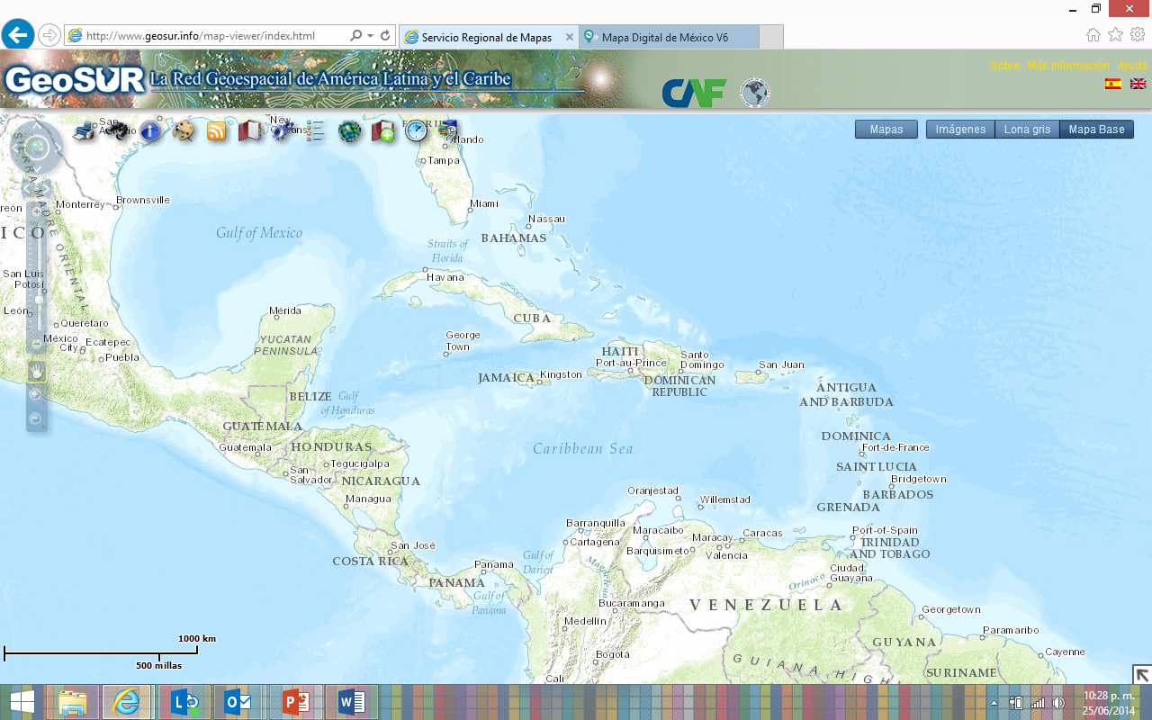
Digital Map of the Caribbean
Notes:
A geomatic solution developed consistent with hardware, software for storage, protection, consultation and dissemination of spatial information, which meets, inter alia, with the following features:
The design solutions will allow each country to publish its geographic services compliant with international standards in order to achieve regional interoperability and the Caribbean Spatial Data Infrastructure building.

Slide 14
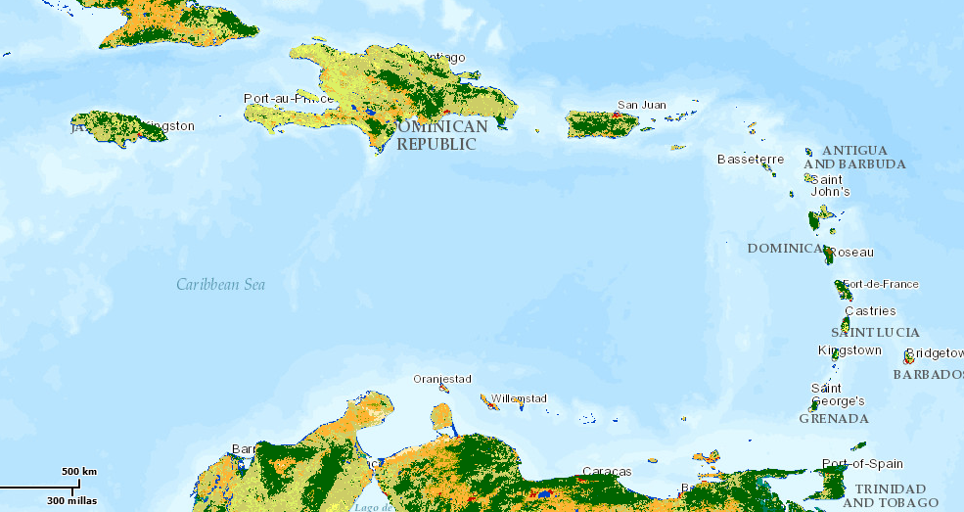
Land Cover Map
Notes:
As part of the investments, we acquired satellite images of different scales to build a complete Land Cover Map of the region with homogeneous characteristics and standards.

Slide 15
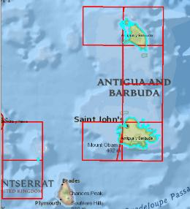
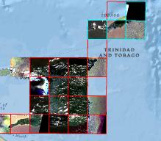
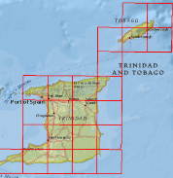
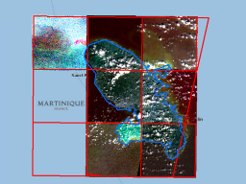
Land Cover Map
861 Rapid Eye satellite images (covering 220,474 km²) were acquired, corresponding to 16 island countries in the Caribbean region included in the Project
Image resolution is 5.3 m; 5-bands, in color
Notes:
Haití 26,949km2

Slide 16
4. Incorporation to UN-GGIM
UN-GGIM 4 – New York, August 2014
UN-GGIM: Americas 1 – Mexico City, September 2014
UN-GGIM 5 – New York, August 2015
UN-GGIM: Americas 2 - Mexico City, November 2015
UN-GGIM 6 – New York, August 2016
UN-GGIM: Americas 3 – Mexico City, October 2016
UN-GGIM 7 – New York, August 2017
UN-GGIM: Americas 4 – Santiago, April 2017
UN-GGIM 8 – New York, August 2018
UN-GGIM: Americas – Mexico City, November 2018
Notes:
the representatives of the Caribbean countries joined and have attended the annual sessions of UN-GGIM and UN-GGIM: Americas since 2014.

Slide 17
Main benefits
Reduce gaps and strengthening the spatial data Infrastructures for the countries in the Region
Improve decision-making for Disaster Risk Reduction (DRR)
Strengthen the technological infrastructure for the generation of geospatial information
Improve the skills and abilities through courses and workshops
Promote the incorporation of best practices and techniques developed at the United Nations Committee of Experts on Global Geospatial Information Management.
Incorporate Caribbean countries into
the activities of the Global Committee (UN-GGIM) and the specific one for the Americas (UN-GGIM: Americas)
Notes:
Some of the main benefits of the project are to…
The closing of the project was on November 2018 and
By 2019 the continuity of the work is being sought through new forms of funding that allow capitalizing the efforts and continuing to strengthen the geospatial capacities of the region.

Slide 18
The main benefits, mentioned by the respondents, for their countries when included in the Caribbean Project were:
1. Development of the infrastructure for an SDI
2. Development of Capacities oriented to the development of an SDI
3. Knowledge of good practices in the implementation of an SDI
4. Inclusion in the Geodetic Reference Framework
THEMES
PERCENTAJE
VERY
LITTLE
IMPORTANT
LESS
IMPORTANT
MODERATLY
IMPORTANT
VERY
IMPORTANT
Geographical Information Analysis
70%
STRATEGIC OBJECTIVE
IMPORTANT
Geographic Database
70%
0%
10%
20%
20%
50%
Geoestatistics Data
60%
Strengthen of the geodetic network on the region
Disseminate Geographic Data
10%
20%
10%
20%
40%
International Standards
60%
Promote Geographic Data use
0%
20%
10%
40%
30%
GIS-base Platform and Geo-Services
60%
Building Capacities
0%
10%
10%
10%
70%
Metadata
60%
Use of Geographic Standards
0%
10%
10%
50%
30%
Remote Sensing
40%
Updating Information Technologies
0%
20%
20%
20%
40%
Geographic Information Systems
40%
Geographic Metadata
0%
10%
20%
50%
20%
Use of Software
30%
Geodesy
20%
Cartography
10%
Photointerpretation
10%
Photogrammetry
10%
Notes:
. The Project stablished 7 strategic objectives
1.Strengthen of the Geodesic Network on the Region (increase permanent or mobile GNSS stations)
2. Disseminate Geographic Data (Create the Caribbean´s Digital Map)
3. Promote the use of Geographic data
4. Capacity building program
5. Use of geographic stantards
6. Updating informatic Technology
7. Geographic metadata
To know the improvements obtained with the Caribbean Project and the satisfaction of the participating countries with the implementation of the 7 strategic objectives, a survey was conducted on "Evaluation of the results of the Caribbean Project", divided into 5 sections: 1. Assessment of improvements, 2. Satisfaction evaluation, 3. Future in strengthening of an SDI, 4. Short-Term activities and 5. Additional information.
The survey was answered by 10 of the 17 countries that participated throughout the 4 years of the Project.
Antigua and Barbuda
Bahamas
Barbados
Belize
Cuba
Guyana
Jamaica
Sint Maarten
St. Vincent
Suriname
Table 1
70% of the respondents consider that the topics “Geographic Information Analysis” and “Geographic Database” are topics that require a strengthening of the capacities in their country.
Table 2
Most respondents (≥40%) rated the strategic objectives "Building Capacities", "Strengthen of the geodetic network on the region", "Disseminate Geographic Data" and "Updating Information Technologies" as Very Important for their country.
The rest of the objectives were qualified in their majority (≥40%) as “Important”.

Slide 19
Workshops was classified into 4 categories, with specific courses each of them:
1. Competences to produce geographic data and cartography
2. Integration, organization, and dissemination of GIS
3. Use of Geospatial Information in decision making
4. Transversal competences
WORKSHOPS
VERY
LITTLE
IMPORTANT
LESS
IMPORTANT
MODERATLY
IMPORTANT
IMPORTANT
VERY
IMPORTANT
THEMATIC AREAS
VERY
UNNECESSARY
UNNECESSARY
NECESSARY
VERY
NECESSARY
Geodesy (2014) | 0% | 10% | 20% | 40% | 30%
Cartography (2015) | 10% | 20% | 0% | 30% | 40%
Use of Geodetic Equipment (2016) | 0% | 0% | 20% | 30% | 50%
Land Cover Map Classification (2016) | 0% | 10% | 20% | 30% | 40%
Land Cover Map verification (2017) | 0% | 10% | 20% | 40% | 30%
Geodetic Processing (2017) | 10% | 10% | 10% | 40% | 30%
Geographic Metadata (2016) | 0% | 0% | 30% | 30% | 40%
Spatial Data Infrastructure (2016) | 0% | 10% | 10% | 10% | 70%
MxSIG (2017) | 0% | 10% | 10% | 30% | 50%
GIS (2016) | 0% | 20% | 10% | 20% | 50%
Geo-portals and Geo-services with MxSIG (2016) | 0% | 20% | 0% | 40% | 40%
Geostatistical Data Use (2017) | 0% | 10% | 10% | 30% | 50%
Free Software Q-GIS (2017) | 10% | 30% | 10% | 10% | 40%
Geospatial Data Quality (2017) | 0% | 10% | 20% | 40% | 30%
Geographic Information Standards (2015) | 0% | 10% | 10% | 40% | 40%
UN_GGIM on RDD (2016) | 0% | 0% | 20% | 50% | 30%
Competences to produce geographic data and cartography | 10% | 40% | 30% | 20%
Integration, organization, and dissemination of GIS | 0% | 10% | 30% | 60%
Use of Geospatial Information in decision making | 0% | 10% | 20% | 70%
Transversal competences | 0% | 30% | 40% | 30%
Notes:
Table 1
Most respondents (≥40%) rated all workshops in categories 2 "Integration, organization, and dissemination of GIS" and 3 "Use of Geospatial Information in decision making" as "Very Important" in the development of the geographic information of their country.
In the categories 1 "Competences to produce geographic data and cartography" and 4 "Transversal competences" the workshops were qualified by most the respondents (≥40%) as "Very important" and "Important". The workshop that most respondents (>70%) rated as "Very Important" was "Spatial Data Infrastructure".
Table 2
Most the respondents (≥40%) rated as "Very Needy" to continue strengthening in their country, the thematic areas of training 3 "Use of Geospatial Information in decision making" and 2 "Integration, organization, and dissemination of GIS ".
The thematic area of ​​training 4 "Transversal competences" was qualified mostly (≥40%) as "Necessary", and the thematic area of ​​training 1 "Competences to produce geographic data and cartography" as ""unnecessary" to strengthen in their countries.

