Slide 1
UN-GGIM Americas
Access and Use of Geospatial Information for Disasters and Climate Change
Geospatial Information Capacity Survey
Diagnosis and Gap Analysis
Ninth Session of the United Nations Committee of Experts on Global Geospatial Information Management (UN-GGIM)
New York City
5 August 2019
Nouri Sabo
Louis Brown
Yves Moisan

Slide 2
Presentation contents
The Americas Region
The Global Strategic Framework for GI&S for DRM
UN-GGIM Americas Working Groups
Status of the work of the Working Group on for Disasters & Climate Change
Survey Results Recap and Gap Analysis
Future Work

Slide 3
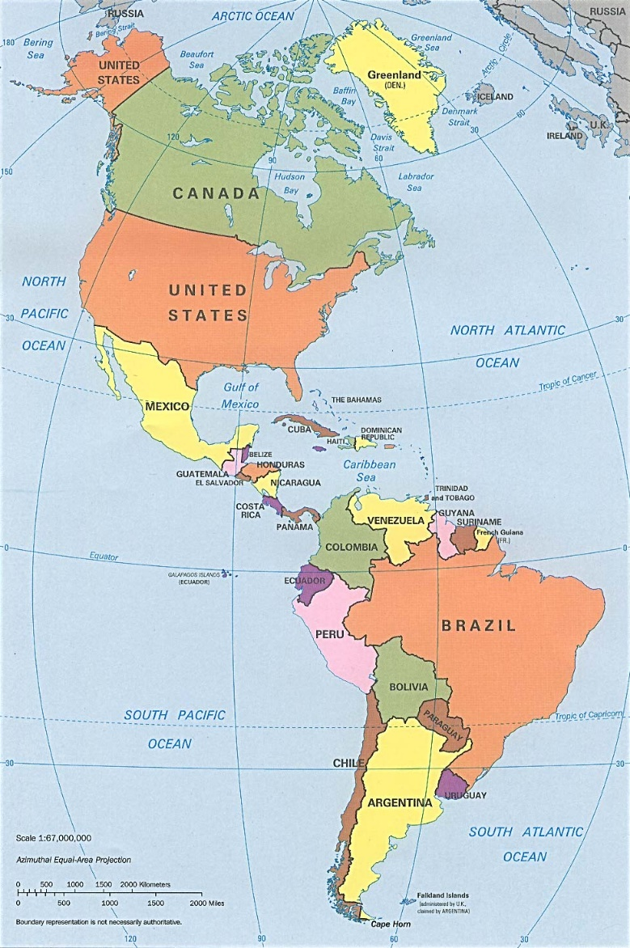
The Americas Region
Spans both hemispheres, north and south
40 independent countries plus several Caribbean Overseas Countries and Territorries (OCT’s)
16 million square miles
Population 1 billion plus
Main languages: English, Spanish, Portuguese, French
Disasters : flooding, hurricanes, landslides, wildfires, earthquakes, volcanos, tsunamis, droughts, disease outbreaks
By CIA, original political map from Perry-Castañeda Library Map Collection University of Texas Library Online, Public Domain, https://commons.wikimedia.org/w/index.php?curid=1839902

Slide 4
The Global Strategic Framework (GSF)
Goal : quality geospatial information and services are available and accessible in a timely and coordinated way to support decision-making and operations within and across all sectors and phases of the emergency cycle
Expected outcome : the human, economic and environmental risks and impacts of disasters are prevented and reduced through the use of geospatial information and services
Status
  adopted by UNGGIM Committee of Experts on 7 August 2017
  endorsed by ECOSOC on 20 June 2018
Notes:
Related to : 2030 Agenda for SDG; Sendai Framework DRR

Slide 5





GSF : Five Priorities for Action
Governance and Policies
Awareness Raising and Capacity Building
Data Management
Common Infrastructure and Services
Resource Mobilization

Slide 6
UN-GGIM Americas Working Groups

Slide 7
UN-GGIM Americas DRR & CC : Objective
Promote the development and shared use of geospatial information in policies, programs and projects for Disaster Risk Reduction & Climate Change
Implement the Global Strategic Framework for Disasters

Slide 8
DRR & CC WG : Status of Work
Survey results and analysis presented last year in NYC at Eighth Session
Gap analysis completed (and presented here); will be shared in working group for final version

Slide 9
Survey Results Recap
Caribbean and Central American countries expressed the greatest gaps
Countries expressed the need for:
  access to better data for preparedness and response
  robust network facilities, namely for internet
  mobile-friendly geospatial data and services
Countries are supportive of GGIM and mostly want implementations to materialize
An interesting gap appears to be lack of legislation and policies to promote open access to GI for DRM
Collaboration is key for capacity building in GIM for DRM
“Collaboration moves at the speed of trust, and trust moves at the speed of understanding”

Slide 10
Gap Analysis - Methodology
Gaps were qualified/interpreted against:
  the five priority areas of the Global Strategic Framework (GSF)
  recommendations of the Sendai framework
Generalized to sub-regions rather than per country
  countries within sub-region have more in common than with countries in other sub-regions
Gaps were cast into action items

Slide 11
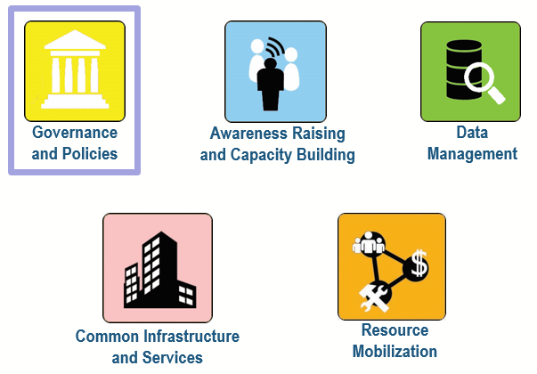
Action items - GSF1
Create per-country working group (WG) on GI related to DRM
  WG led by “business domain” (DRM) experts supported by technical (GIS) experts
  WG should be instituted by legislation and be integrated in SDI
Encourage inter-country WG cooperation
Policies on collaboration, coordination and data acquisition and sharing are established, promoted and implemented : open data and open standards
Define roles, responsibilities, authoritative sources
Policies on data maintenance / GI strengthening

Slide 12
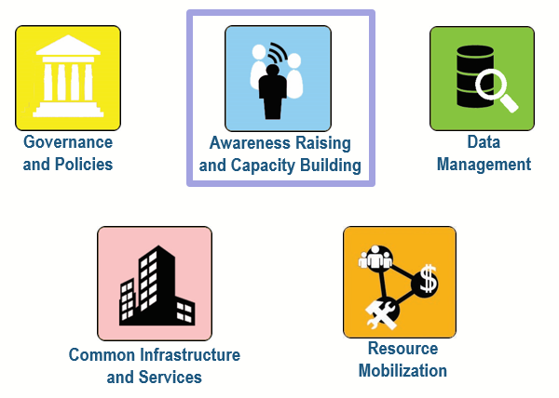
Action items – GSF2
Communication material understandable by politicians and public
Promote awareness in formal and non-formal education settings
Examine capacities of entities (private sector, education institutions) to provide training
Conduct capacity building initiatives with first responders, NGOs, etc.
Foster development of the science of vulnerability and risk reduction in academia and research agencies

Slide 13
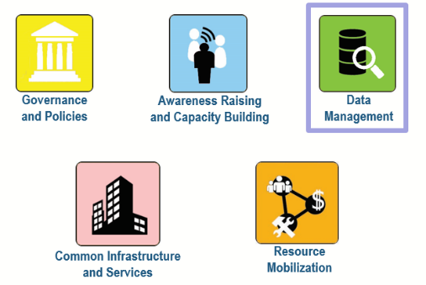
Action items – GSF3
EO real-time data is made available for use when events occur (several data issues raised in survey with respect to access, usage and sharing)
Geospatial databases are developed based on common standards, protocols and processes across all phases of disaster risk management
Data interoperability is an important concern
Notes:
4. In what thematic areas is it necessary to expand knowledge? The U.S respondent said : « interoperability ». Still an issue even in the richest country in the world.

Slide 14
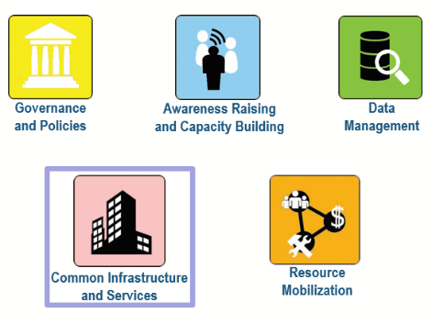
Action items – GSF4
GI facilities to have a common operational picture of disaster events : geoportal
Robust infrastructure (potentially cloud-based) to ensure resilience and scalability during an event
Look into possibility of sharing infrastructure/systems on a regional basis or with other countries or UN agencies
Ensure data and services are available on mobile devices : responsive design
Again : interoperability is a major concern

Slide 15
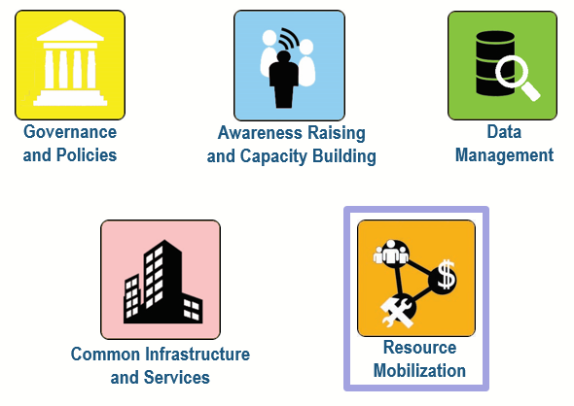
Action items – GSF5
Ensure properly trained personnel is available on short notice
Idea of shared resources among countries that could be called on specific events
Foster Best Practices, especially Communities of Practice

Slide 16
Gap Analysis - Summary
Low (small gap) to High (large gap)
GSF priority areas for action | North America | Caribbean | Central America | South America
Governance and Policies | Low | High | High | Average
Awareness Raising and Capacity Building | Average | High | High | High
Data Management | Low | Average | Average | Average
Common Infrastructure and Services | Average | High | Average | Average
Resource Mobilization | Average | High | High | High
Interpretation hints
Governance and Policies: collaboration, information sharing, roles and responsibilities, geospatial information standards
Awareness Raising and Capacity Building: training and education, VGI, etc.
Data Management: continued management of geospatial datastores
Common Infrastructure and Services: interoperability and collaboration
Resource Mobilization: fast deployment of trained human resources and general resources

Slide 17
Future Work
Survey considerations
  survey questions should be better aligned on detailed breakdown of the five GSF areas for action; benefit : easier comparisons between survey answers in the future
  questions should be worded so as to be applicable to all countries, even those without an SDI
  domains of answer should be thought so as to minimize free form text; benefit : answers are easier to plot and measure
  survey should be web based; benefit : easier for respondents and easier to share and reference
Proposition: organize sub-working groups to work around selected GSF action items, e.g.
  Data management
  Common Infrastructure and Services
Several reports due in the next year and a half (e.g. Implementation of capacity building strategy) culminating with a final report end 2020

Slide 18


