Slide 1
ECLAC report on geospatial information activities
Fifth Session UN-GGIM: Americas /
Regional Workshop on the integration of Statistical and Geospatial Information
Mexico City, 06 - 08 November 2018

Slide 2
Contributing to the encounter of the regional statistical and geospatial communities
in the region
Thirty-sixth session of ECLAC
XVI Meeting of the Executive Committee CEA-ECLAC
IV Session of UN-GGIM: Americas
IX Meeting of the CEA-ECLAC
V Session of UN-GGIM: Americas
2018
2017
Seminar: Towards the Integration of Geospatial and Statistical Information
Coordination at regional level between ECLAC and UNGGIM Americas, to support and follow-up the integration process
First extended encounter between the statistical and geospatial communities
Workshop on the Integration of Geospatial and Statistical Information: from Dialogue to Action
Resolution 712 on the regional integration of statistical and geospatial information
2016
Quinta Sesión UN-GGIM: Américas / Taller Regional en integración de información estadística y geoespacial, Ciudad de México, 06 a 08 de noviembre 2018

Slide 3
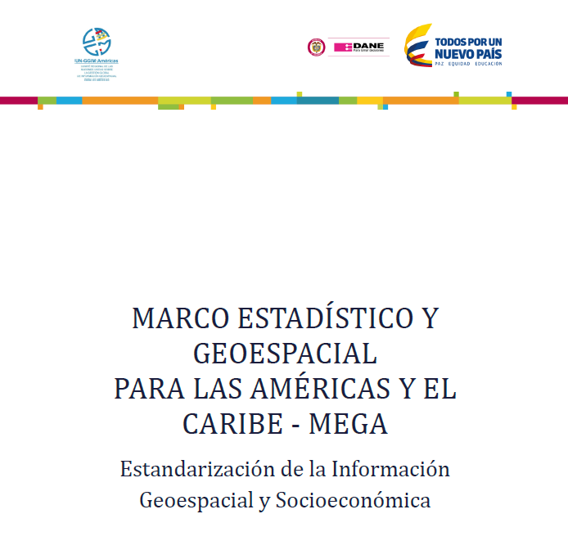
Promoting and articulating the participation of national statistical offices
in the MEGA Project
Sending Version 1.0 of the MEGA to the authorities of the NSO
Request for designation of technical focal points of the NSO in the MEGA
Sending of Standardization Document MEGA V.8 to NSO
Submission of comments by the NSO on Standardization Document MEGA V.8 to GT-IIEG
2018
2017
Quinta Sesión UN-GGIM: Américas / Taller Regional en integración de información estadística y geoespacial, Ciudad de México, 06 a 08 de noviembre 2018

Slide 4
Evaluating and supporting the progress of the national processes of integration of statistical and geospatial information
Medium and long term Programs
Technical assistance
Pilot Projects
Horizontal cooperation
Collection and dissemination of use cases
First conversations
Not started yet
Quinta Sesión UN-GGIM: Américas / Taller Regional en integración de información estadística y geoespacial, Ciudad de México, 06 a 08 de noviembre 2018

Slide 5
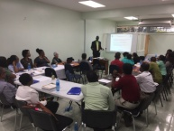
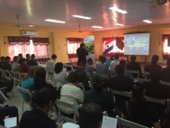
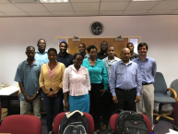
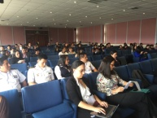
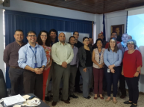
Technical assistance 2018
Surinam
Rep. Dominicana
Guyana
Paraguay
Dominica
Ecuador
Costa Rica
GLSC
LSD
INEC
IGN
DGEEC
DISER GEMIL
INEC
IGM
MLIS
Quinta Sesión UN-GGIM: Américas / Taller Regional en integración de información estadística y geoespacial, Ciudad de México, 06 a 08 de noviembre 2018

Slide 6
Technical assistance 2018
Global Geospatial Statistics Framework (national level implementation perspectives)
Census Mapping Update
Diagnosis of geospatial information management
Use of geospatial information to support the 2030 Agenda
Exchange of experiences / challenges of the NSO and the NGO
Contents of the workshops
Quinta Sesión UN-GGIM: Américas / Taller Regional en integración de información estadística y geoespacial, Ciudad de México, 06 a 08 de noviembre 2018

Slide 7
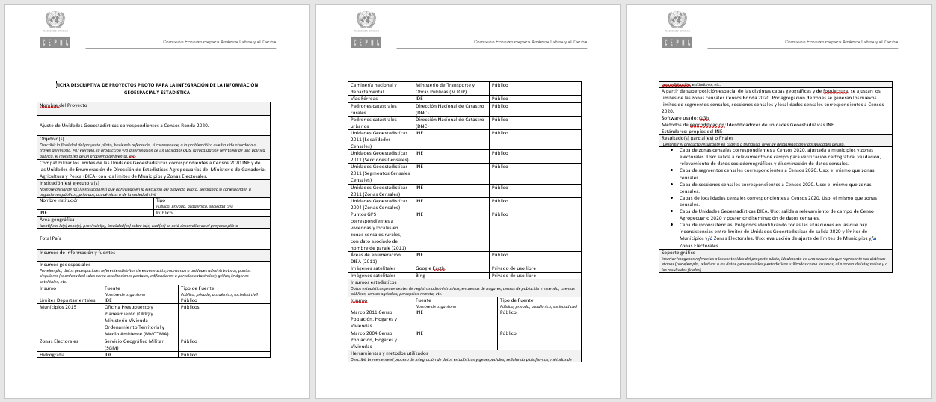
Collection and dissemination of use cases
Project's name
Goals
Executing organizations
Geographical extension
Inputs and sources of information (statistics and geospatial)
Methods and tools used
Partial and final results
Graphic support
Quinta Sesión UN-GGIM: Américas / Taller Regional en integración de información estadística y geoespacial, Ciudad de México, 06 a 08 de noviembre 2018

Slide 8
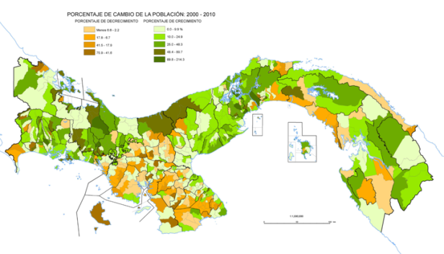
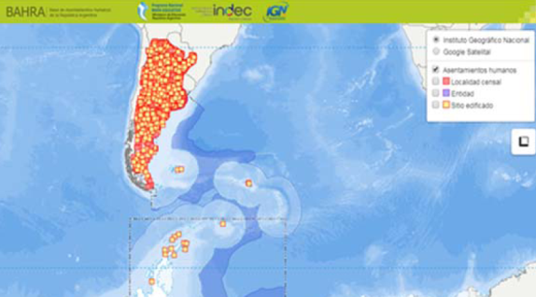
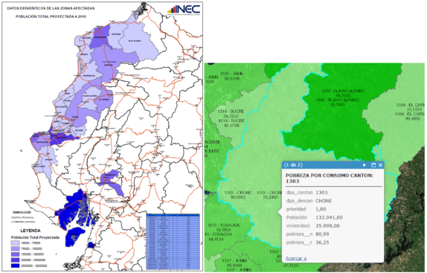
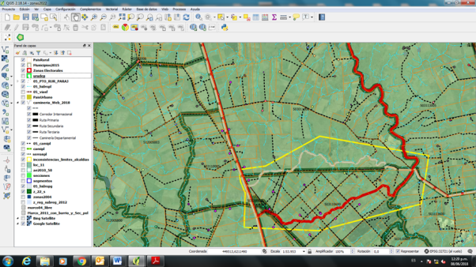
Collection and dissemination of use cases
Activity in progress, input for technical assistance and the creation of a regional bank of good practices for the integration of geospatial and statistical information
Quinta Sesión UN-GGIM: Américas / Taller Regional en integración de información estadística y geoespacial, Ciudad de México, 06 a 08 de noviembre 2018

Slide 9
Other relevant activities / milestones
Adhesion of ECLAC, as Participating Organization, to the Earth Observation Group (July 2017).
Incorporation of a Geospatial Regional Advisor to the staff of the Statistics Division of ECLAC (July 2017).
Participation of ECLAC in the XIV Plenary Meeting of the Earth Observation Group, GEO (Washington, October 2017).
Participation of the Executive Secretary of ECLAC in the Fifth High Level Forum of UN-GGIM (Mexico City, November 2017).
Participation of ECLAC in a Training Workshop for the Caribbean countries in geospatial information and the 2030 Agenda (New York, August 2018)
Contribution in the revision of the Statutes of the Regional Committee UN-GGIM: Americas (October 2018)
Participation and support in the UN World Geospatial Information Congress (November 2018)
Quinta Sesión UN-GGIM: Américas / Taller Regional en integración de información estadística y geoespacial, Ciudad de México, 06 a 08 de noviembre 2018

Slide 10
Perspectives 2019
Follow up and support in the countries where ECLAC technical assistance began during this year
Open and carry out a new cycle of technical assistance for the countries to apply (focus on the implementation of the Global Statistical Geospatial Framework and the Integrated Geospatial Information Framework)
Promote horizontal cooperation activities, leveraging the experience and learning of the countries
Assess the national geospatial capacities for the production of SDGs
Continue the support to the MEGA project
Collect and disseminate experiences in the integration of statistical and geospatial information
Elaborate a regional policy for the geospatial information development in the region
Quinta Sesión UN-GGIM: Américas / Taller Regional en integración de información estadística y geoespacial, Ciudad de México, 06 a 08 de noviembre 2018

Slide 11
Thank you !
Fifth Session UN-GGIM: Americas / Regional Workshop on the integration of Statistical and Geospatial Information
Mexico City, 06 - 08 November 2018

