Slide 1
SNIT- SDI Chile
Ministry of National Assets
www.ide.cl
Macarena Pérez García
Secretaria Ejecutiva SNIT-IDE Chile

Slide 2
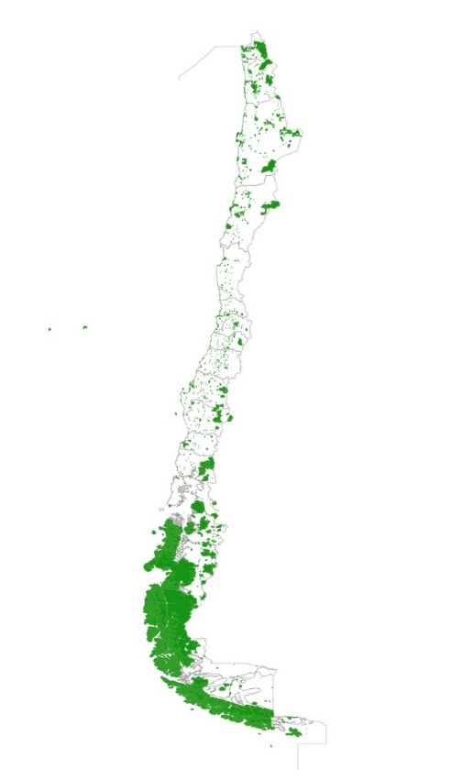
The SNIT is the National System of Coordination of Territorial Information. This is a permanent inter-institutional coordination mechanism for the management of public territorial information in the country, composed of the State institutions generating and using this information. It was created through the D.S N ° 28/2006 of the Ministry of National Assets.
To maximize the benefits derived from the use of territorial information, it is necessary to work under the concept of a Geospatial Data Infrastructure (SDI).
Council of Ministers of the
Territorial Information
Executive Secretary
Interministerial Technical Committee
Coordination, through working groups, thematic areas, regional and sectoral coordination

Slide 3
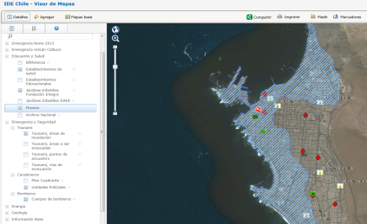
Current Information Management and Standardization Groups
Cadastral
Public Infrastructure
Transport
Hydrography
Heritage
Road Axes
Images
Administrative Policy Division
Regional information
Geodesy
National Standards Committee

Slide 4
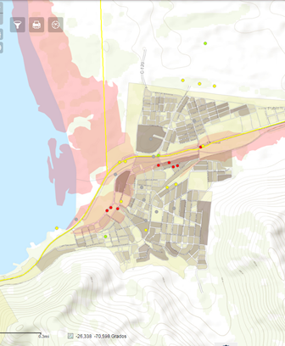
WORKING GROUP OF DISASTERS
Multi-sectoral team of experts
Updated territorial information
Emergency Protocol
2018-2019
- QUINTERO PUCHUNCAVÍ POISONING
- WILDFIRE SOUTH OF CHILE, FLOODING NORTH OF CHILE
- RE INTRODUCTION OF VECTOR AEDES AEGYPTI IN THE TARAPACÁ REGION
2020 (MARCH 19)
COVID-19

Slide 5
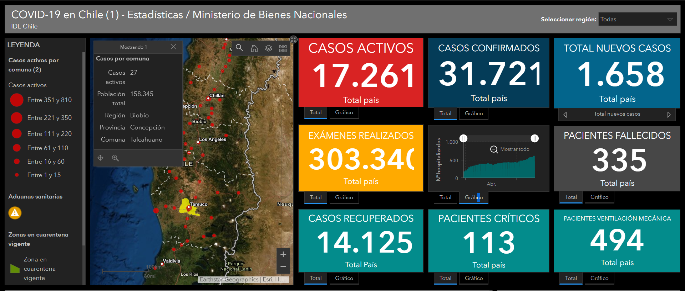
https://idechile.maps.arcgis.com/apps/opsdashboard/index.html#/6662268991094e439cee1a6f9f0e46ea

Slide 6
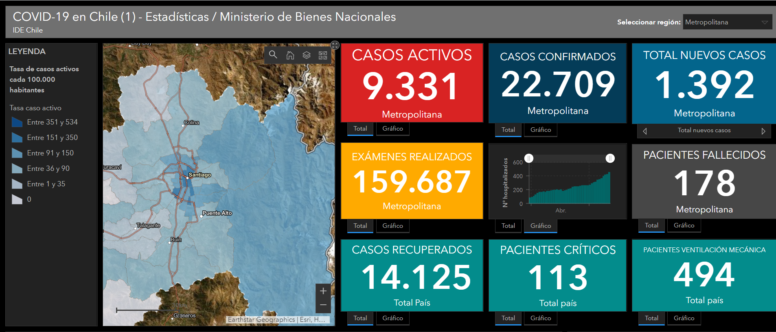
https://idechile.maps.arcgis.com/apps/opsdashboard/index.html#/6662268991094e439cee1a6f9f0e46ea

