Slide 1
WORKGROUP
REGIONAL GEOSPATIAL DATA INFRASTRUCTURES
22 Mayo 2018
Macarena Pérez García
Geógrafo
Secretaria Ejecutiva del Sistema Nacional de Coordinación de Información Territorial

Slide 2
OBJECTIVE OF THE WORKING GROUP
GENERAL
To Coordinate the actions related to the implementation, development and promotion of the Geospatial Data Infrastructures (SDIs) of the Member States of UN-GGIM Americas.
SPECIFIC
A. To Diagnose the current status (2018) of the National Geospatial Data Infrastructures in the region, considering the components of the SDIs.
B. To Design evaluation and monitoring tool regarding the state of progress of the National SDIs of the region.
C. To Spread initiatives and good regional practices in the field of IDES, generating a basic guideline document regarding the operation of SDIs.
D. To Promote and carry out training and improvement instances in the region regarding different components of the SDIs.

Slide 3
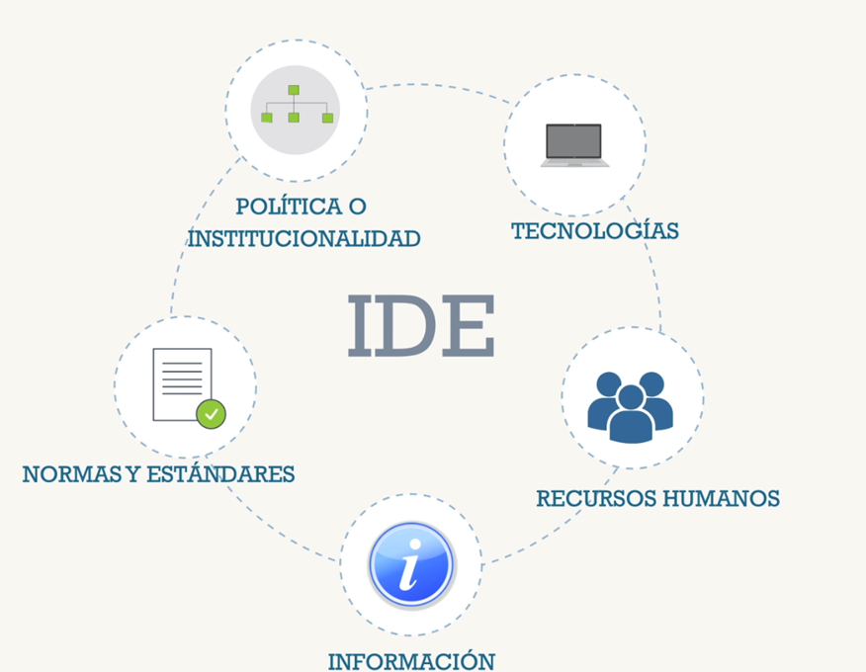
GENERAL CONTEXT AND BASIS
It is possible to understand a Geospatial Data Infrastructure (SDI) as a collection of technologies, policies and institutional arrangements that facilitate the availability and access to spatial or geographic information (GI)
Regional advances in this area are disparate, and largely respond to initiatives that address the particular reality, giving answers to situations of natural risks, cadastral surveys or others, being a mission for UN-GGIM Americas, to contribute in the definition of regional policies that are linked to the Global Framework

Slide 4
Work for 2018 – Objetives
OBJECTIVES | RESULTS | TIME LIMIT
A. Diagnose the current status (2018) of the Geospatial Data Infrastructures in the Region, considering the components of the SDIs. | * Diagnostic instrument (survey) | April-18
 | * Document Summary of regional results (Excel spreadsheets, Report) | May 2018 - Julio 2018
 | * Panel of dynamic mapping of results by country. First advance August 2018 | August 2018- Octubre 2018
JUNE- JULY (10) 2018

Slide 5
Representative of each country in the regional committee.
*For example the professional in charge of the SDI
Who will answer the survey?
what do we want to know?
how will we show the results
State of the components of the SDI

Slide 6
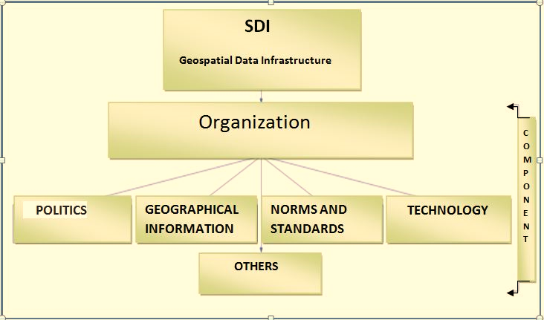
Structure of
the survey
STATISTICS / GEOSPATIAL INFORMATION
DISASTERS
ACADEMIC NETWORK

Slide 7
Designation of tasks to Member States
GRUPO DE TRABAJO | COORDINADOR | ESTADOS MIEMBROS
GT- IDE | Chile | Dominica, Belize, México, Antigua & Barbuda, Colombia, Barbados, Perú, Guyana, Brasil, Costa Rica, Haïti, Bahamas, República Dominicana, El Salvador, Bolivia, Panamá, Venezuela, Honduras, Argentina, Paraguay, USA, St. Maarten, Trinidad & Tobago, Jamaica, Nicaragua, Uruguay, Grenada, Ecuador, Cuba
- 2018: request to answer brief interview about specific components of SDI.
-2019: request of technical documents for elaboration of repository.

Slide 8
WORKGROUP
REGIONAL GEOSPATIAL DATA INFRASTRUCTURES
22 Mayo 2018
Macarena Pérez García
Geógrafo
Secretaria Ejecutiva del Sistema Nacional de Coordinación de Información Territorial

