Slide 1
Working Group
REGIONAL GEOSPATIAL DATA INFRASTRUCTURES
Macarena Pérez García – Chile Junio 2019

Slide 2
2019
OBJETIVOS | RESULTADOS | TIME LINE
Regional diagnostic survey of initiatives in terms of use, standards and other elements associated with the use of IDES in the region. | *Report *Dashboard | Marzo 2019- Junio 2019
Systematization of information. Web documentation repository | Matrix of information (related with 2018-2019 survey) | Julio 2019- Diciembre 2019
 | * Web documentation repository | Julio 2019- Diciembre 2019
B. Design evaluation and monitoring tool regarding the progress status of the Regional SDI
C. Disseminate regional initiatives and good practices in the area of IDES, generating a basic guideline document regarding the operation of SDI

Slide 3
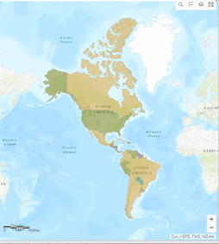
Design evaluation and monitoring tool regarding the progress status of the Regional SDI
application of survey for a regional indicator
9 countries did not respond to this survey
Only one working group include question in the survey / Academia Network
Processing of results during the month of June - July
NEXT TASKS
- 2019 results analysis
- comparative analysis 2018-2019
- Dynamic dashboard

Slide 4
Disseminate regional initiatives and good practices in the area of SDI
Request for the countries (JUNE 2019)
Web documentation repository
Matrix of information (related with 2018-2019 survey)
4 Countries / Survey

